Slide 1
Cotton Disease Detection using AI-ML
Student’s Name: Gr. No. Roll No.
DIGVIJAY PATIL 11910480 77

Slide 2
Contents
Contents
Introduction
Problem Statement
Literature review and state of the Art technology/Method
Purposed Methodology
Objectives of Project
Domain Technology and Tools / software's used
Outcome
Reference

Slide 3
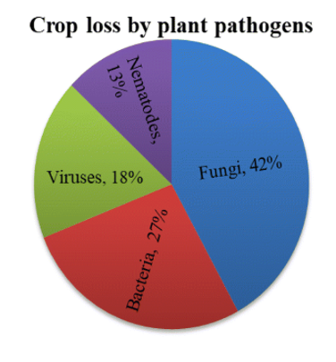
Introduction
Agriculture is one of the most significant sectors in the Indian Economy which occupy 43% of Indian Geographical area and contribute 16.1% to Indian GDP.
Fungi and bacteria are main cause of leaf diseases
Plant diseases is one of the most widely facing issues by farmers

Slide 4
Problem Statement
Problem statement
Problem :- In India, most of the farmers are not highly literate as they can detect diseases on plants and find suitable crop for their farm .
Solution :- I am designing a webapp which will predict the disease detection of the crops based on their leaves and tell to take suitable as per the soil texture as well.

Slide 5



Domain
Domain Technology and Tools / software's used
Domain :- Agriculture
Tools / Languages used for project :-
Backend development
Python
Jupyter Notebook
Spider
Frontend Development
HTML
JavaScript.
3) CSS
Technology :- Machine Learning

Slide 6
Literature review
Literature review
Research paper No. | 1 | 2
Name | Shantanu Phadikar and Jaya Sil uses pattern recognition techniques for the identification of rice disease | Mr. Sanjay Mirchandani1, Mihir Pendse2, Prathamesh Rane3, Ashwini Vedula4 PLANT DISEASE DETECTION AND CLASSIFICATION USING IMAGE PROCESSING AND ARTIFICIAL NEURAL NETWORKS
Accuracy | 0.95863 | 0.8875
Algorithms used | Random Forest, Linear Regression, Ridge Regression, Lasso, KNN, XGBoost | Support Vector Machine , random forest , artificial neural network
Features | Leaf, soil textures, state and so on. | Soil colour, texture and its constituents.

Slide 7
Literature review
Literature review
Santanu phadikar and jaya sil, “rice disease identification using pattern recognition”, proceedings of 11th international conference on computer and information technology (ICCIT 2008) 25-27 december, 2008, khulna.
Mr. Sanjay Mirchandani1, Mihir Pendse2, Prathamesh Rane3, Ashwini Vedula4 PLANT DISEASE DETECTION AND CLASSIFICATION USING IMAGE PROCESSING AND ARTIFICIAL NEURAL NETWORKS
A. Meunkaewjinda, P. Kumsawat, K. Attakitmongcol and A.Srikaew, “grape leaf disease detection from color imagery using hybrid intelligent system”, proceedings of ECTI-CON 2008.

Slide 8
Literature review
Literature review
4. Grel, Tomasz "Region of interest pooling explained". deepsense.io. 5. Krizhevsky, Alex; Sutskever, Ilya; Hinton, Geoffrey E. (2017-05-24). "ImageNet classification with deep convolutional neural networks" .
5. Disease Detection Using Different Algorithms by Trimi Neha Tete (Department of Electrical & Electronics) and Sushma Kamlu.

Slide 9
objectives
We are going to design a web-application by using deep learning and computer vision concept for farmers.
This web-app will be very useful for farmers and crop disease analyzers.
The main objective of our web-application is to design a platform which will detect diseases on crop leaves, and which will farmers to take care of crops and take prevention to avoid such diseases. It will help to get better crops as well as cash . we are designing web-app by using html and CSS .

Slide 10
Workflow
workflow
Domain and topic Finalization
Selections of Languages
Learning Phase (Languages and coding)
Coding
Final webapp

Slide 11
Outcomes
Outcome
A web app which will help farmers to detect diseases on crop
Recommend crops to be planted to get better yield
Recommend the fertilizers to be used for the crops

Slide 12
References
references
Santanu phadikar and jaya sil, “rice disease identification using pattern recognition”, proceedings of 11th international conference on computer and information technology (ICCIT 2008) 25-27 december, 2008, khulna, bangladesh.
A. Meunkaewjinda, P. Kumsawat, K. Attakitmongcol and A.Srikaew, “grape leaf disease detection from color imagery using hybrid intelligent system”, proceedings of ECTI-CON 2008.
Https://pylessons.Com/keras-resnet-tutorial/
Https://medium.Com/analytics-vidhya/plants-doctor-detecting-diseases-in-plants-e5c44c569bdb
Https://datasetsearch.Research.Google.Com/
Https://pytorch.Org/docs/stable/index.Html

Slide 13
Thank You

